Slide 1
IT Project Management
Project Time Management

Slide 2


Project Time Management
Project time management involves the processes required to ensure timely completion of a project.
The major processes in developing the project time schedule are:
Activity definition
Activity sequencing
Activity duration estimating
Schedule development
Schedule control

Slide 3
Importance of Project Schedules
Managers often cite delivering projects on time as one of their biggest challenges
Time has the least amount of flexibility; it passes no matter what happens on a project
Schedule issues are the main reason for conflicts on projects, especially during the second half of projects

Slide 4
Project Time Management Processes
Activity definition: identifying the specific activities/tasks that the project team members and stakeholders must perform to produce the project deliverables
Activity sequencing: identifying and documenting the relationships between project activities
Activity resource estimating: estimating how many resources a project team should use to perform project activities
Activity duration estimating: estimating the number of work periods that are needed to complete individual activities
Schedule development: analyzing activity sequences, activity resource estimates, and activity duration estimates to create the project schedule
Schedule control: controlling and managing changes to the project schedule

Slide 5
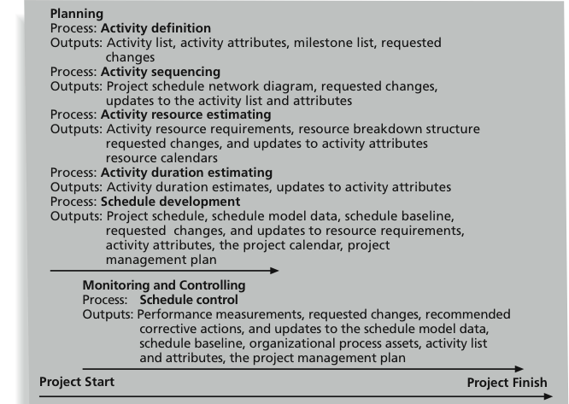
Project Time Management Summary

Slide 6
Activity Definition
Project schedules grow out of the basic documents that initiate a project
Project charter includes start and end dates and budget information
Scope statement and WBS help define what will be done
Activity definition involves developing a more detailed WBS and supporting explanations to understand all the work to be done so you can develop realistic cost and duration estimates

Slide 7
Activity Definition
The basis for creating a project schedule is derived from four project time management processes
Activity definition – further defining the scope
Activity sequencing – further defining the time
Activity resource and activity duration (further defining the time and cost)
The main outputs of this process are an activity list, activity attributes, and milestone list.

Slide 8
Activity Lists and Attributes
An activity list is a tabulation of activities to be included on a project schedule that includes:
The activity name
An activity identifier or number
A brief description of the activity
Activity attributes provide more information such as predecessors, successors, logical relationships, leads and lags, resource requirements, constraints, imposed dates, and assumptions related to the activity

Slide 9
Milestones
A milestone is a significant event that normally has no duration
Not every deliverable or output created for a project is a milestone
It often takes several activities and a lot of work to complete a milestone
They’re useful tools for setting schedule goals and monitoring progress
Examples include obtaining customer sign-off on key documents or completion of specific products such as software modules or the installation of new hardware

Slide 10
Activity Sequencing
After defining project activities, the next step is activity sequencing
Involves reviewing the activity list and attributes, project scope statement, milestone list and approved change requests to determine the relationships between activities
A dependency or relationship is the sequencing of project activities or tasks
You must determine dependencies in order to use critical path analysis

Slide 11
Network Diagrams
Network diagrams are the preferred technique for showing activity sequencing
A network diagram is a schematic display of the logical relationships among, or sequencing of, project activities
Two main formats are the arrow and precedence diagramming methods

Slide 12
Methods of developing Project Network Diagram
There are 2 methods are used for developing Network Diagrams.
Arrow Diagramming Method (ADM) or Activity-on-Arrow (AOA)
Precedence Diagramming Method (PDM)

Slide 13
Arrow Diagramming Method (ADM)
Also called activity-on-arrow (AOA) project network diagrams
Activities are represented by arrows
Nodes or circles are the starting and ending points of activities
Can only show finish-to-start dependencies

Slide 14
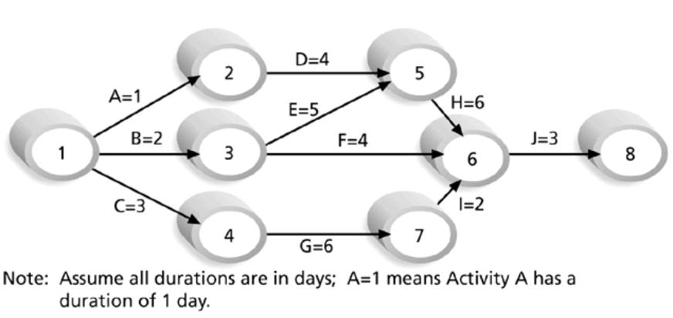
Activity-on-Arrow (AOA) Network Diagram for Project X

Slide 15
Precedence Diagramming Method (PDM)
Activities are represented by boxes
Arrows show relationships between activities
More popular than ADM method and used by project management software
Better at showing different types of dependencies

Slide 16
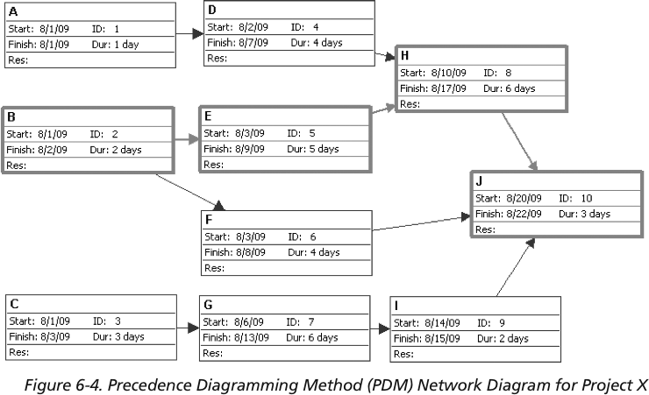
Sample PDM Network Diagram for Project X

Slide 17
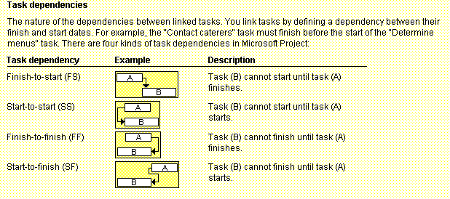
Task Dependency Types

Slide 18
Activity Duration Estimating
Duration includes the actual amount of time worked on an activity plus elapsed time
Effort is the number of workdays or work hours required to complete a task. Effort does not equal duration
People doing the work should help create estimates, and an expert should review them

Slide 19
Schedule Development
Schedule development uses results of the other time management processes to determine the start and end date of the project and its activities
Ultimate goal is to create a realistic project schedule that provides a basis for monitoring project progress for the time dimension of the project
Important tools and techniques include Gantt charts, PERT analysis, critical path analysis, and critical chain scheduling

Slide 20
Gantt Charts
Gantt charts provide a standard format for displaying project schedule information by listing project activities and their corresponding start and finish dates in a calendar format

Slide 21
Gantt Charts
Symbols include:
A black diamond: milestones or significant events on a project with zero duration
Thick black bars: summary tasks
Lighter horizontal bars: tasks
Arrows: dependencies between tasks

Slide 22
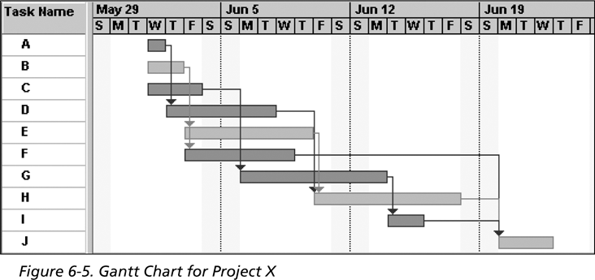
Gantt Chart for Project X
Note: Darker bars would be red in Project 2007 to represent critical tasks

Slide 23
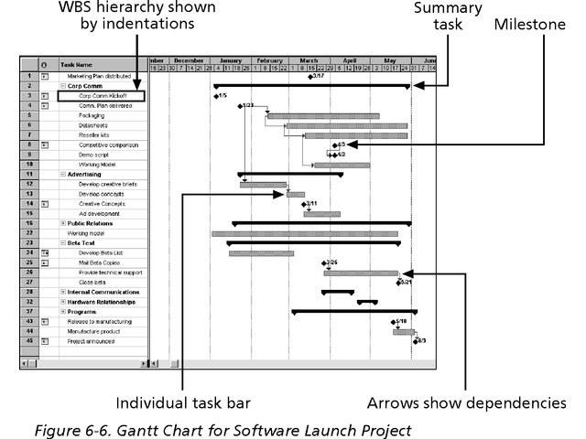
Gantt Chart for Software Launch Project

Slide 24
Milestones
Milestones are significant events on a project that normally have zero duration
You can follow the SMART criteria in developing milestones that are:
Specific
Measurable
Assignable
Realistic
Time-framed

Slide 25
Critical Path Method (CPM)
CPM is a project network analysis technique used to predict total project duration
A critical path for a project is the series of activities that determines the earliest time by which the project can be completed
The critical path is the longest path through the network diagram and has the least amount of slack or float

Slide 26
Finding the Critical Path
First develop a good project network diagram
Add the durations for all activities on each path through the project network diagram
The longest path is the critical path

Slide 27
Simple Example of Determining the Critical Path
Consider the following project network diagram. Assume all times are in days.
a. How many paths are on this network diagram?
b. How long is each path?
c. Which is the critical path?
d. What is the shortest amount of time needed to complete this project?

Slide 28
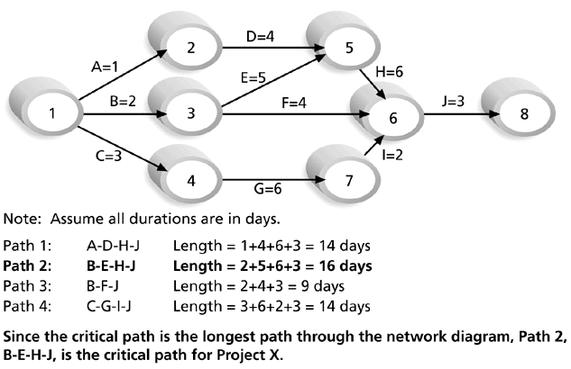
Determining the Critical Path for Project X

Slide 29
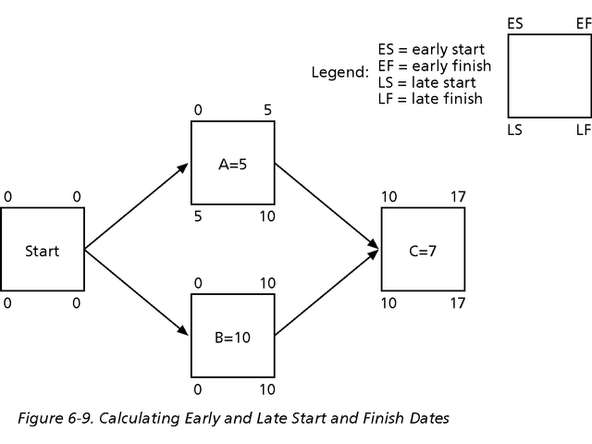
Calculating Early and Late Start and Finish Dates

Slide 30
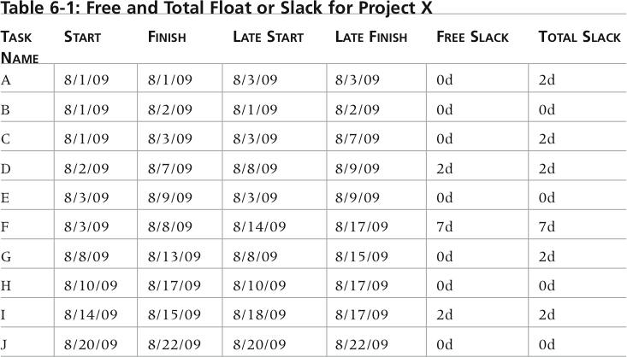
Free and Total Float or Slack for Project X

Slide 31
Program Evaluation and Review Technique (PERT)
PERT is a network analysis technique used to estimate project duration when there is a high degree of uncertainty about the individual activity duration estimates
PERT uses probabilistic time estimates based on using optimistic, most likely, and pessimistic estimates of activity durations

Slide 32
PERT Formula and Example
PERT weighted average formula:
optimistic time + 4X most likely time + pessimistic time
6
Example:
PERT weighted average =
8 workdays + 4 X 10 workdays + 24 workdays = 12 days 6
where 8 = optimistic time, 10 = most likely time, and 24 = pessimistic time

Slide 33
Controlling Changes to the Project Schedule
Perform reality checks on schedules
Allow for contingencies (an event that may or may not happen)
Hold progress meetings with stakeholders and be clear and honest in communicating schedule issues

Slide 34
Working with People Issues
Strong leadership helps projects succeed more than good PERT charts
Project managers should use:
Empowerment
Incentives
Discipline
Negotiation

Slide 35
Using Software to Assist in Time Management
Software for facilitating communications helps people exchange schedule-related information
Decision support models help analyze trade-offs that can be made
Project management software can help in various time management areas

Slide 36
Words of Caution on Using Project Management Software
Many people misuse project management software because they don’t understand important concepts and have not had training
You must enter dependencies to have dates adjust automatically and to determine the critical path
You must enter actual schedule information to compare planned and actual progress

Slide 37
References
“Information Technology Project Management”, Kathy Schwalbe, sixth Edition, THOMSON Course Technology

